Slide 1
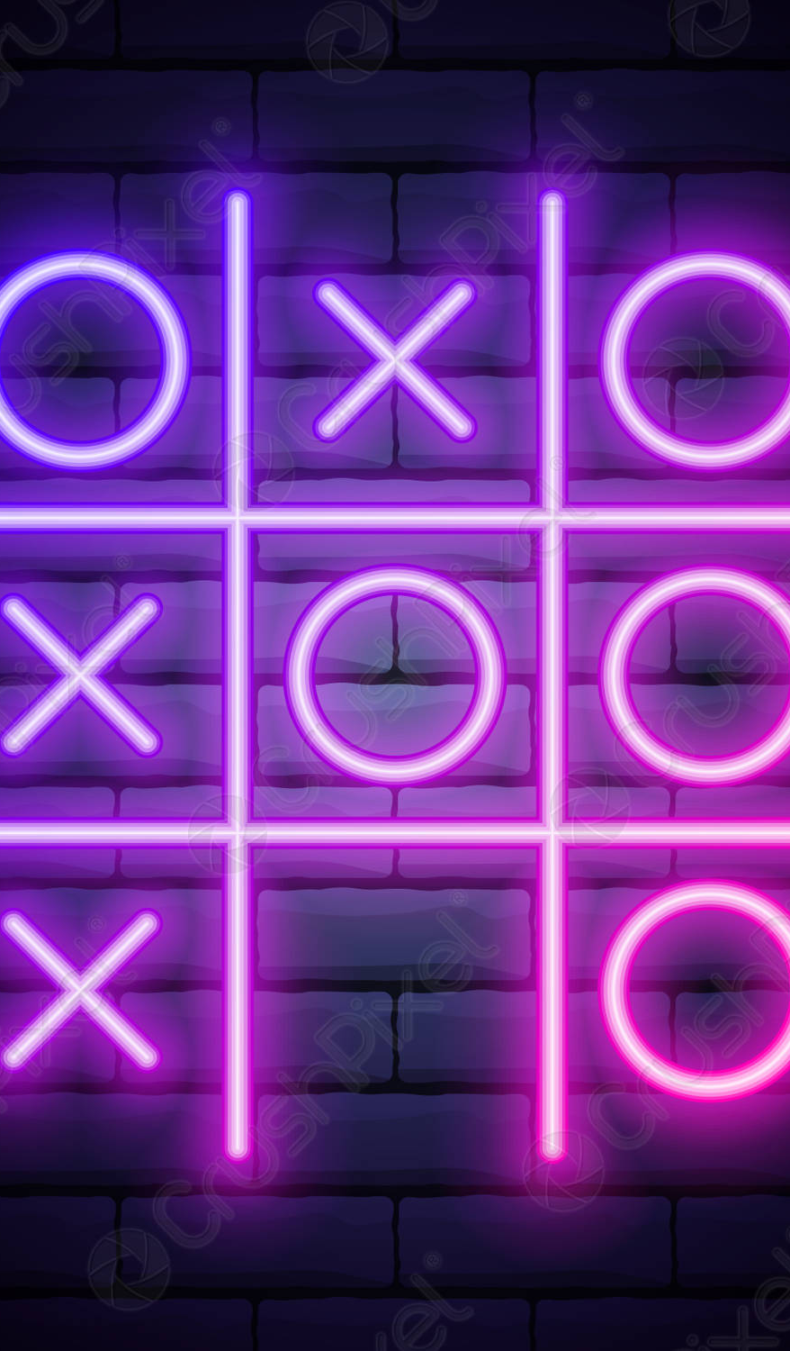

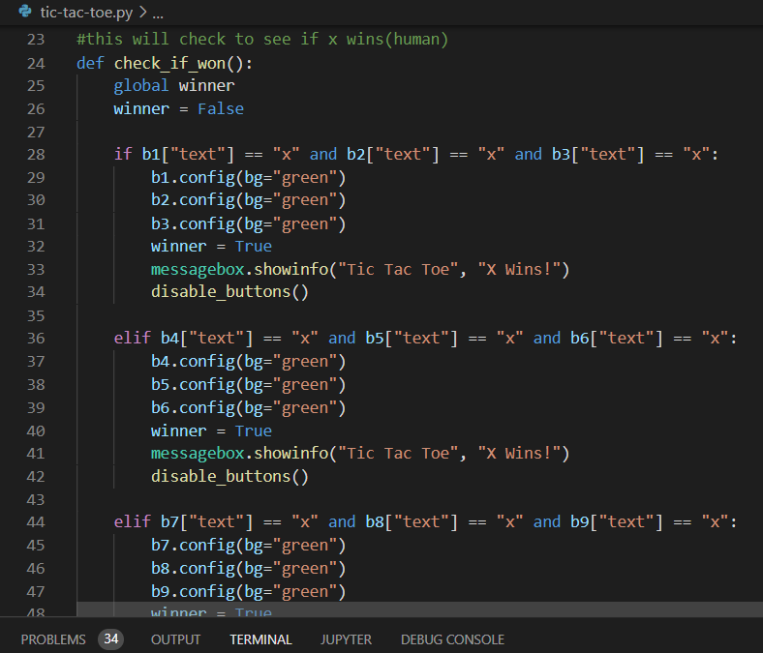
Tic Tac Toe
Play your favorite childhood game against your friends or by yourself against the computer!
Features a Player v Player or Player v Computer option in the main menu
Created By: Beau Wilkins

